Slide 1
UNIT -IV
SPARK With Machine Learning

Slide 2
Designing a Machine Learning System
A modern large-scale data environment includes the following requirements:
It must integrate with other components of the system, especially with data collection and storage systems, analytics and reporting, and frontend
applications.
It should be easily scalable and independent of the rest of the architecture. Ideally, this should be in the form of horizontal as well as vertical scalability.
It should allow efficient computation in respect of the type of workload in mind, that is machine learning and iterative analytics applications. If possible, it should support both batch and real-time workloads.

Slide 3
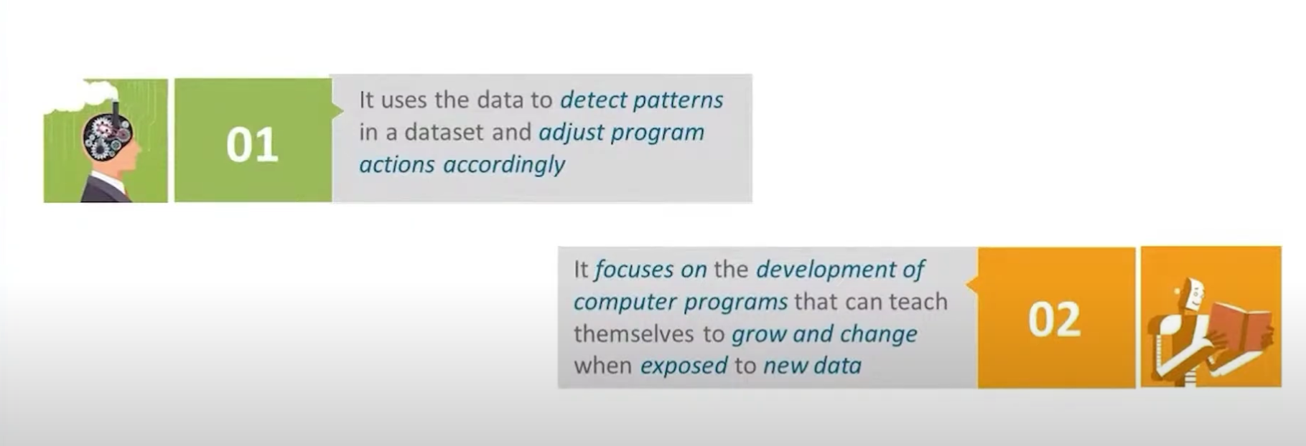

Slide 4
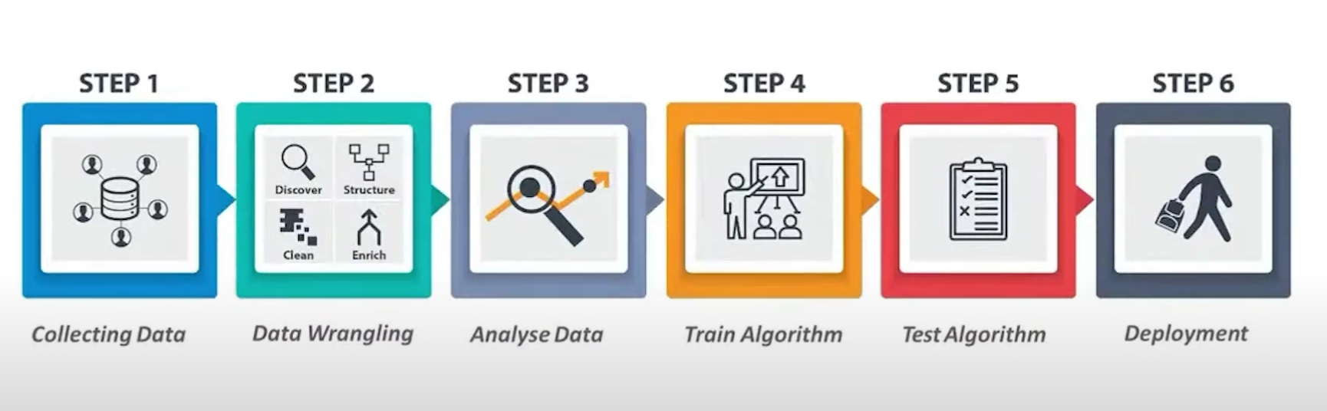

Slide 5
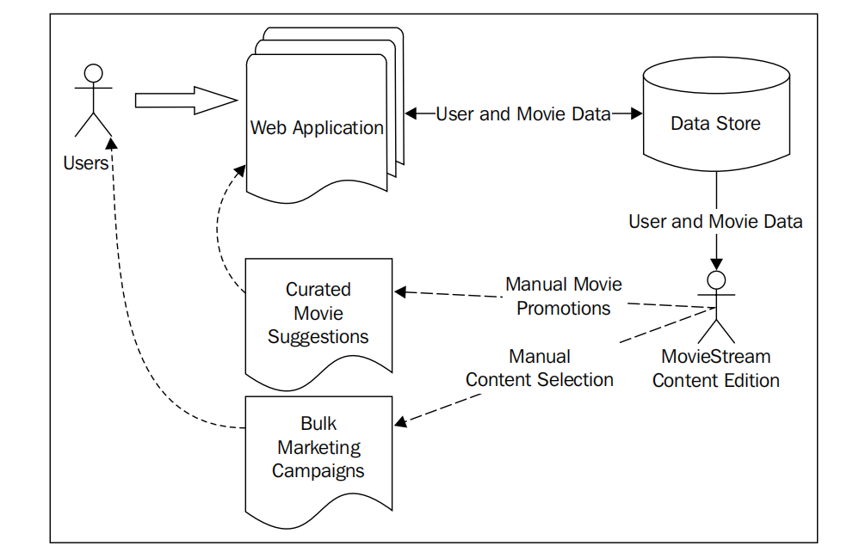
Movie Streams Example Architecture

Slide 6
Business use cases for a machine learning system
Why doesn’t MovieStream simply continue with human-driven decisions?
There are many reasons to use machine learning but the most important ones are mentioned here:
The scale of data involved means that full human involvement quickly becomes infeasible as MovieStream grows
Model-driven approaches such as machine learning and statistics can often benefit from uncovering patterns that cannot be seen by humans (due to the size and complexity of the datasets)
Model-driven approaches can avoid human and emotional biases (as long as the correct processes are carefully applied)

Slide 7
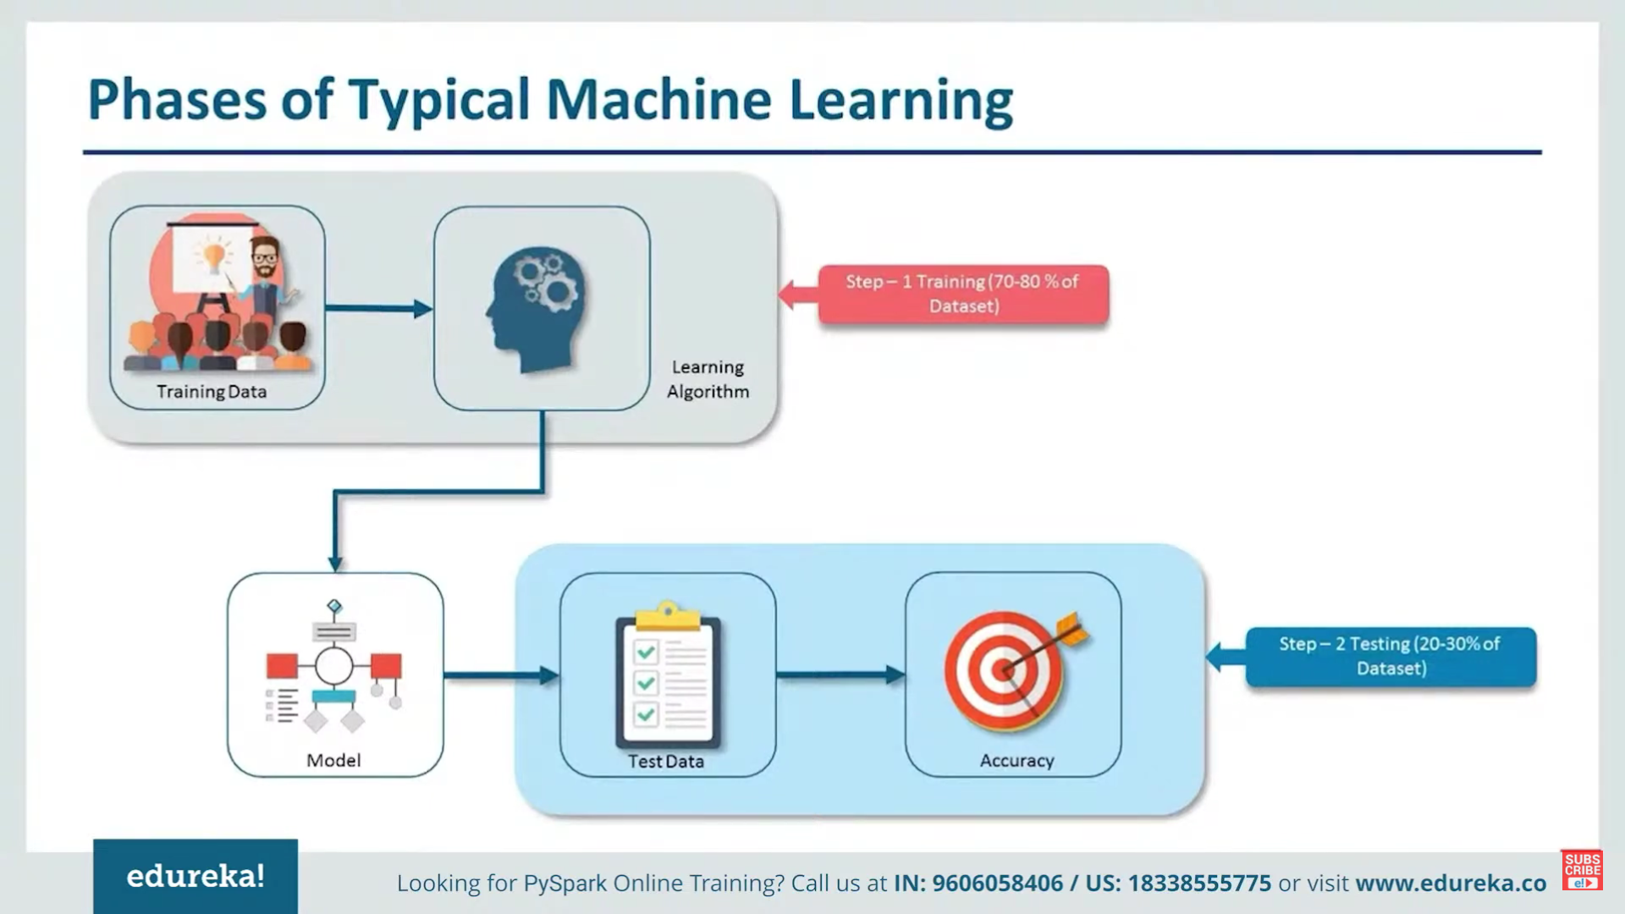

Slide 8
Personalization
Perhaps one of the most important potential applications of machine learning in MovieStream’s business is personalization.
Recommendations
These are essentially a subset of personalization. Recommendation generally refers to presenting a user with a list of items that we hope the user will be interested in.
Personalization is very similar to recommendations, but while recommendations
are usually focused on an explicit presentation of products or content to the user,
personalization is more generic and, often, more implicit.

Slide 9
Targeted marketing and customer segmentation
Targeted marketing uses a model to select what to target at users. While generally recommendations and personalization are focused on a one-to-one situation, segmentation approaches might try to assign users into groups based on characteristics and, possibly, behavioral data.
The approach might be fairly simple or might involve a machine learning model such as clustering.
Either way, the result is a set of segment assignments that might allow us to understand the broad characteristics of each group of users, what makes them similar to each other within a group, and what makes them different from others in different groups.

Slide 10
Predictive modeling and analytics
A third area where machine learning can be applied is in predictive analytics.
This is a very broad term, and in some ways, it encompasses recommendations, personalization, and targeting too. In this context, since recommendations and segmentation are somewhat distinct, we use the term predictive modeling to refer to other models that seek to make predictions.
MovieStream can use past activity and revenue data, together with content attributes, to create a regression model that can be used to make predictions for brand new titles.
As another example, we can use a classification model to automatically assign tags,
keywords, or categories to new titles for which we only have partial data.

Slide 11
Types of machine learning models
Supervised learning:
These types of models use labeled data to learn. Recommendation engines, regression, and classification are examples of supervised learning methods. The labels in these models can be user-movie ratings (for recommendation), movie tags (in the case of the preceding classification example), or revenue figures (for regression).

Slide 12
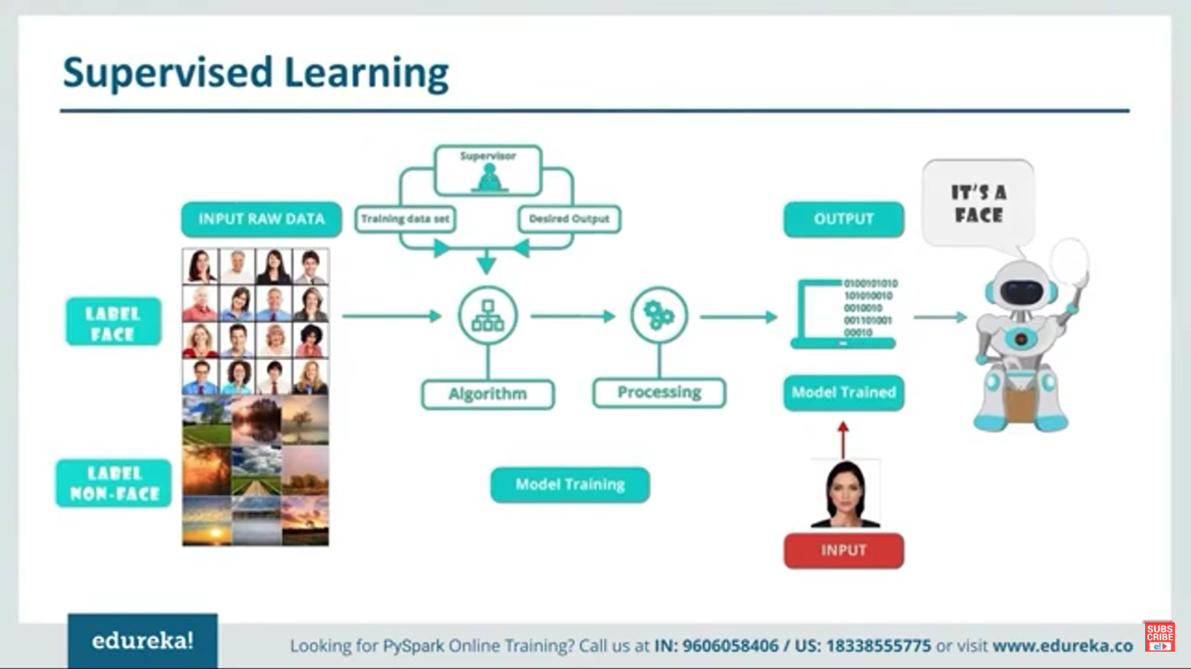

Slide 13
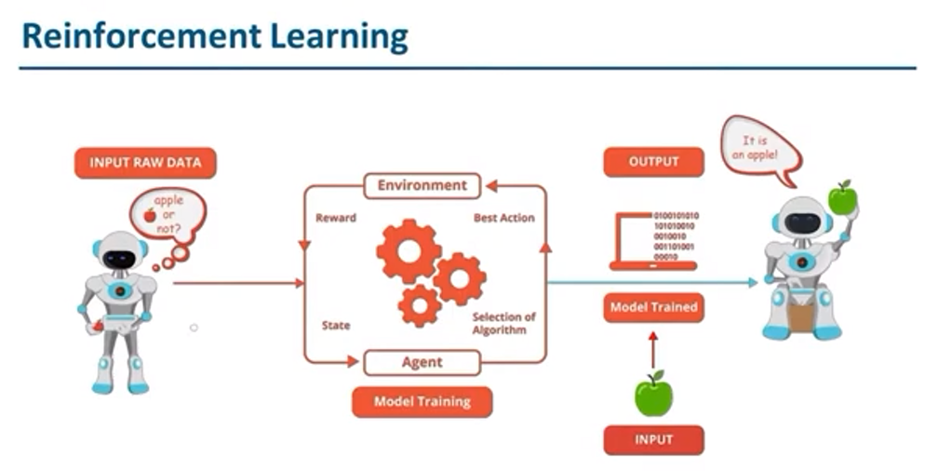

Slide 14
Unsupervised learning:
When a model does not require labeled data, we refer to unsupervised learning. These types of models try to learn or extract some underlying structure in the data or reduce the data down to its most important features. Clustering, dimensionality reduction, and some forms of feature extraction, such as text processing, are all unsupervised techniques.

Slide 15
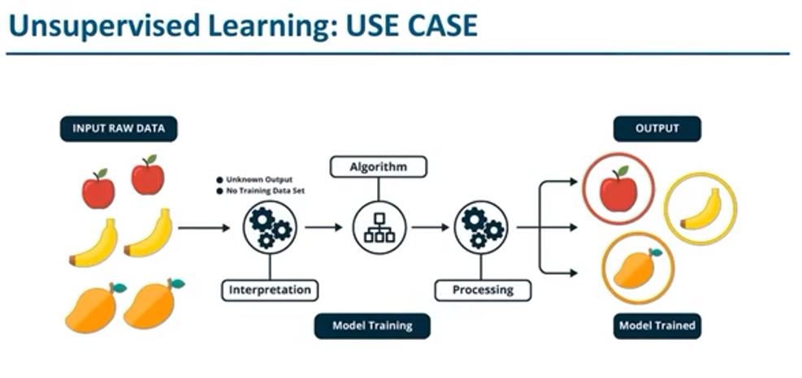

Slide 16
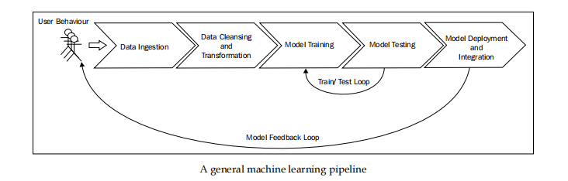
The components of a data-driven machine learning system

Slide 17
Data Ingestion
Data storage can be complex and involve a wide variety of systems, including HDFS,Amazon S3, and other filesystems; SQL databases such as MySQL or PostgreSQL; distributed NoSQL data stores such as HBase, Cassandra, and DynamoDB; and search engines such as Solr or Elasticsearch to stream data systems such as Kafka, Flume, or Amazon Kinesis.
Data cleansing and transformation
Filtering data
Dealing with missing, incomplete, or corrupted data
Dealing with potential anomalies, errors, and outliers
Joining together disparate data sources
Aggregating data

Slide 18
Model training and testing loop
During this phase, we are primarily concerned with model selection. This can refer to choosing the best modeling approach for our task, or the best parameter settings for a given model.
It is also common to explore the application of combinations of different models (known as ensemble methods) in this phase.
This is typically a fairly straightforward process of running our chosen model on our training dataset and testing its performance on a test dataset (that is, a set of data that is held out for the evaluation of the model that the model has not seen in the training phase). This process is referred to as Cross-validation.
Model deployment and integration
Model monitoring and feedback

Slide 19
Batch versus real time
There is a class of machine learning algorithms known as online learning; they update immediately as new data is fed into the model, thus enabling a real-time system.
A common example is an online-optimization algorithm for a linear model, such as stochastic gradient descent. The advantages of these methods are that the system can react very quickly to new information and also that the system can adapt to changes in the underlying behavior (that is, if the characteristics and distribution of the input data are changing over time, which is almost always the case in real-world situations).

Slide 20
Finally, batch-oriented frameworks might make it awkward to handle real-time processes of a streaming nature
Fortunately, Spark’s real-time stream processing component, Spark Streaming, is a good potential fit for real-time machine learning workflows.
Due to the complexities inherent in a true real-time machine learning system, in practice, many systems target near real-time operations. This is essentially a hybrid approach where models are not necessarily updated immediately as new data arrives; instead, the new data is collected into mini-batches of a small set of training data.
These mini-batches can be fed to an online-learning algorithm. In many cases, this approach is combined with a periodic batch process that might recompute the model on the entire data set and perform more complex processing and model selection. This can help ensure that the real-time model does not degrade over time.

Slide 21
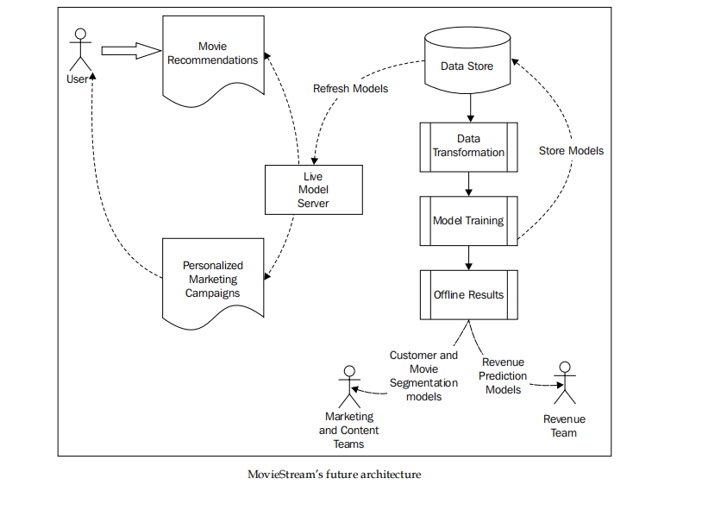
An architecture for a machine learning system

Slide 22
An architecture for a machine learning
01
Presentations are communication tools that can be used as demonstrations, lectures, speeches, reports, and more.
system
02
Presentations are communication tools that can be used as demonstrations, lectures, speeches, reports, and more.

Slide 23
This system also includes:
Collecting data about users, their behavior, and our content titles
Transforming this data into features
Training our models, including our training-testing and model-selection phases
Deploying the trained models to both our live model-serving system as well as using these models for offline processes
Feeding back the model results into the MovieStream website through recommendation and targeting pages
Feeding back the model results into MovieStream’s personalized marketing channels
Using the offline models to provide tools to MovieStream’s various teams to better understand user behavior, characteristics of the content catalogue, and drivers of revenue for the business

Slide 24
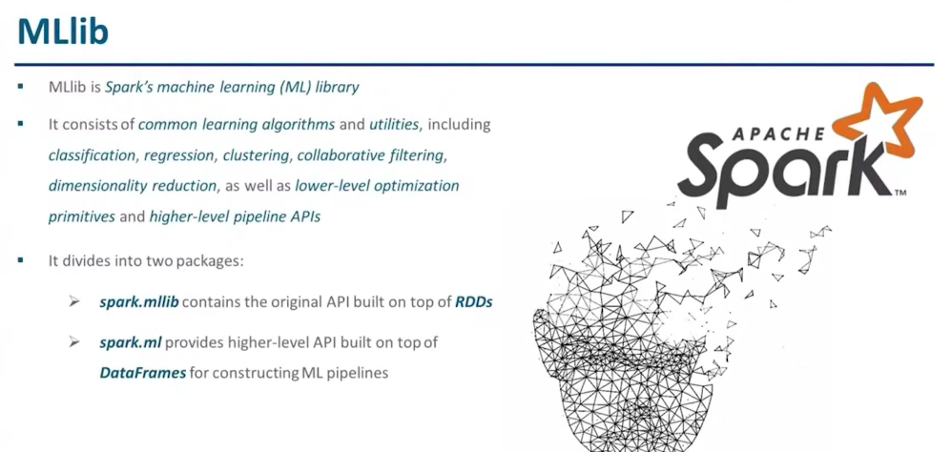

Slide 25
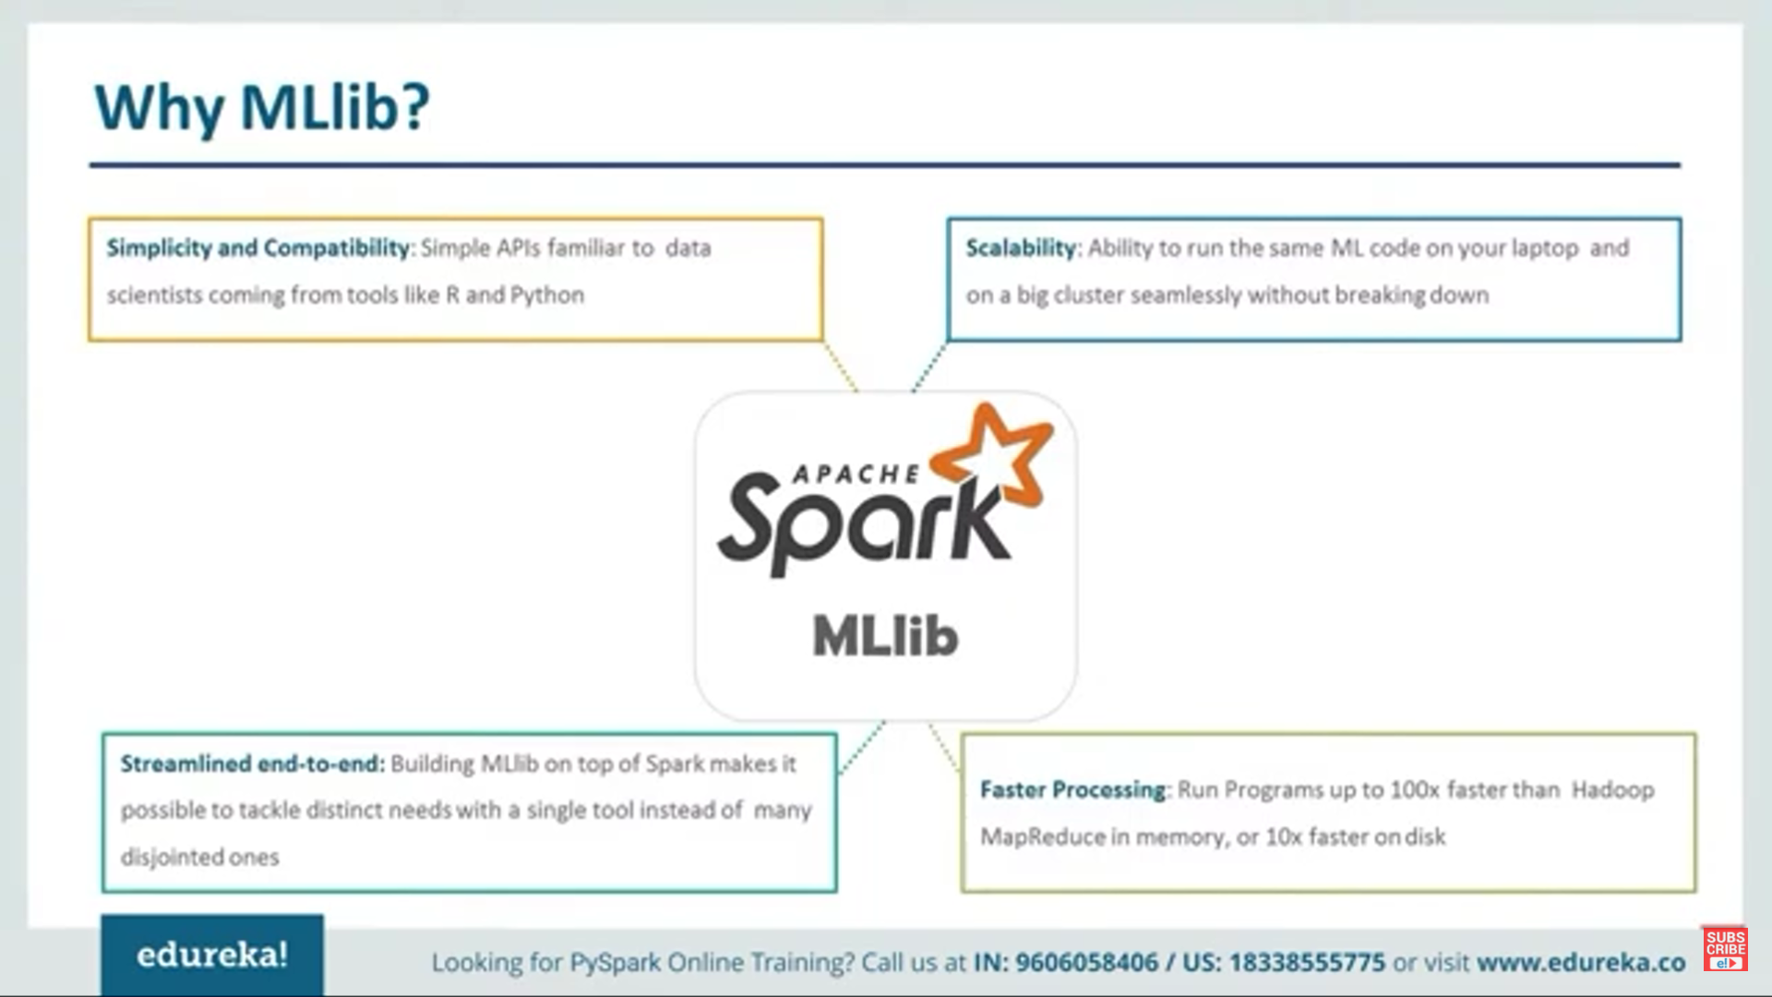

Slide 26
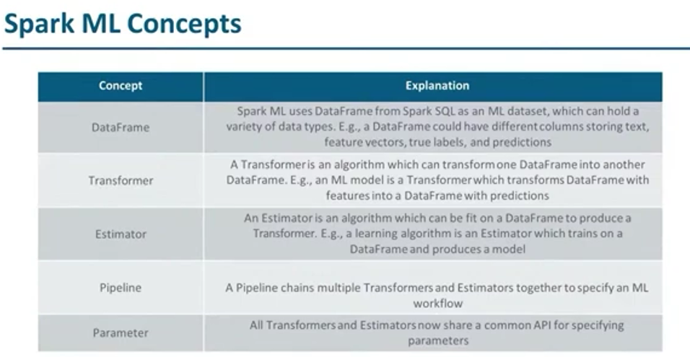

Slide 27
Obtaining, Processing, and Preparing Data with Spark
Accessing publicly available dataset
UCI Machine Learning Repository: This is a collection of almost 300 datasets of various types and sizes for tasks including classification, regression, clustering, and recommender systems. The list is available at http://archive.ics.uci.edu/ml/.
• Amazon AWS public datasets: This is a set of often very large datasets that can be accessed via Amazon S3. These datasets include the Human Genome Project, the Common Crawl web corpus, Wikipedia data, and Google Books Ngrams. Information on these datasets can be found at http://aws.amazon.com/publicdatasets/

Slide 28
Kaggle: This is a collection of datasets used in machine learning competitions run by Kaggle. Areas include classification, regression, ranking, recommender systems, and image analysis. These datasets can be found under the Competitions section at http://www.kaggle.com/competitions.
• KDnuggets: This has a detailed list of public datasets, including some of those mentioned earlier. The list is available at http://www.kdnuggets.com/datasets/index.html.

Slide 29
The MovieLens 100k dataset
The MovieLens 100k dataset is a set of 100,000 data points related to ratings given by a set of users to a set of movies. It also contains movie metadata and user profiles. While it is a small dataset, you can quickly download it and run Spark code on it.
This makes it ideal for illustrative purposes.You can download the dataset from http://files.grouplens.org/datasets/
movielens/ml-100k.zip.Once you have downloaded the data, unzip it using your terminal:
>unzip ml-100k.zip
inflating: ml-100k/allbut.pl
inflating: ml-100k/mku.sh
inflating: ml-100k/README
...
inflating: ml-100k/ub.base
inflating: ml-100k/ub.test
Explore the data set
Visulaize the data

Slide 30
Processing and Transforming data
Filter out or remove records with bad or missing values: This is sometimes unavoidable; however, this means losing the good part of a bad or missing record.
Fill in bad or missing data: We can try to assign a value to bad or missing data based on the rest of the data we have available. Approaches can include assigning a zero value, assigning the global mean or median, interpolating nearby or similar data points (usually, in a time-series dataset), and so on. Deciding on the correct approach is often a tricky task and depends on the data, situation, and one's own experience.
Apply robust techniques to outliers: The main issue with outliers is that they might be correct values, even though they are extreme. Outliers can also be removed or filled in, although fortunately, there are statistical techniques (such as robust regression) to handle outliers and extreme values.
Apply transformations to potential outliers: Another approach for outliers or extreme values is to apply transformations, such as a logarithmic or Gaussian kernel transformation, to features that have potential outliers, or display large ranges of potential values. These types of transformations have the effect of dampening the impact of large changes in the scale of a variable and turning a nonlinear relationship into one that is linear.

Slide 31
Extracting useful features from your data
Features broadly fall into a few categories, which are as follows:
Numerical features: These features are typically real or integer numbers, for example, the user age that we used in an example earlier.
Categorical features: These features refer to variables that can take one of a set of possible states at any given time. Examples from our dataset might include a user's gender or occupation or movie categories.
Text features: These are features derived from the text content in the data, forexample, movie titles, descriptions, or reviews.
Other features: Most other types of features are ultimately represented numerically. For example, images, video, and audio can be represented as sets of numerical data. Geographical locations can be represented as latitude and longitude or geohash data.

Slide 32
Numerical features
In reality, any numerical data can be used as an input variable. However, in a machine learning model, we learn about a vector of weights for each feature. The weights play a role in mapping feature values to an outcome or target variable (in the case of supervised learning models).

Slide 33
Categorical features
Categorical features cannot be used as input in their raw form, as they are not numbers; instead, they are members of a set of possible values that the variable can take. In the example mentioned earlier, user occupation is a categorical variable that can take the value of student, programmer, and so on.Such categorical variables are also known as nominal variables where there is no concept of order between the values of the variable.

Slide 34
To transform categorical variables into a numerical representation, we can use a common approach known as 1-of-k encoding. An approach such as 1-of-k encoding is required to represent nominal variables in a way that makes sense for machine learning tasks. Ordinal variables might be used in their raw form but are often encoded in the same way as nominal variables.

Slide 35
Text features
Tokenization: First, some form of tokenization is applied to the text to split it into a set of tokens (generally words, numbers, and so on).
Stop word removal: Next, it is usual to remove very common words such as "the", "and", and "but" (these are known as stop words).
Stemming: The next step can include stemming, which refers to taking a term and reducing it to its base form or stem.
Vectorization: The final step is turning the processed terms into a vector representation. The simplest form is, perhaps, a binary vector representation, where we assign a value of one if a term exists in the text and zero if it does not.

Slide 36
Normalizing features
Normalize a feature: This is usually a transformation applied to an individual feature across the dataset, for example, subtracting the mean (centering the feature) or applying the standard normal transformation (such that the feature has a mean of zero and a standard deviation of 1).
Normalize a feature vector: This is usually a transformation applied to all features in a given row of the dataset such that the resulting feature vector has a normalized length. That is, we will ensure that each feature in the vector is scaled such that the vector has a norm of 1 (typically, on an L1 or L2 norm).

Slide 37
Using MLlib for feature normalization
from pyspark.mllib.feature import Normalizer
normalizer = Normalizer()
vector = sc.parallelize([x])

Slide 38
Summary
Since Spark supports Scala, Java, and Python bindings, we can use packages available in these languages that provide sophisticated tools to process and extract features and represent them as vectors. A few examples of packages for feature extraction include scikit-learn, gensim, scikit-image, matplotlib, and NLTK in Python; OpenNLP in Java; and Breeze and Chalk in Scala.

Slide 39
Building a Recommendation Engine with Spark
Recommendation engines are probably among the best types of machine learning model known to the general public. Even if people do not know exactly what a recommendation engine is, they have most likely experienced one through the use of popular websites such as Amazon, Netflix, YouTube, Twitter, LinkedIn, and Facebook. Recommendations are a core part of all these businesses, and in some cases, they drive significant percentages of their revenue.

Slide 40
Recommendation engines are most effective in two general scenarios :
Large number of available options for users: When there are a very large number of available items, it becomes increasingly difficult for the user to find something they want. Searching can help when the user knows what they are looking for, but often, the right item might be something previously unknown to them.
A significant degree of personal taste involved: When personal taste plays a large role in selection, recommendation models, which often utilize a wisdom of the crowd approach, can be helpful in discovering items based on the behavior of others that have similar taste profiles.

Slide 41
Types of recommendation models
Content-based filtering
Collaborative filtering

Slide 42
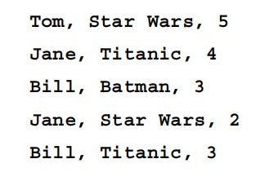
Matrix factorization
Spark's recommendation models currently only include an implementation of matrix factorization.
Explicit matrix factorization
When we deal with data that consists of preferences of users that are provided by the users themselves, we refer to explicit preference data.
Eg: ratings, thumbs up, likes, and so on that are given by users to items.
These ratings and form a two-dimensional matrix with users as rows and items as columns. Each entry represents a rating given by a user to a certain item. Since in most cases, each user has only interacted with a relatively small set of items, this matrix has only a few non-zero entries.

Slide 43
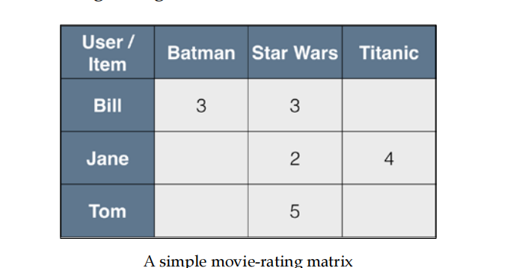
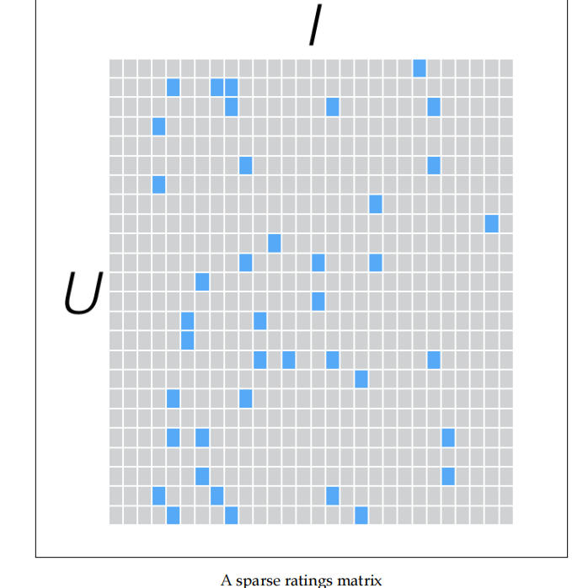
Matrix factorization (or matrix completion) attempts to directly model this user-item matrix by representing it as a product of two smaller matrices of lower dimension.
Thus, it is a dimensionality-reduction technique. If we have U users and I items, then our user-item matrix is of dimension U x I and might look something like the one shown in the following diagram:

Slide 44
Implicit matrix factorization
Specifically, the explicit feedback matrix is divided into the product of the user latent factor matrix and item true latent factor matrix.
The implicit feedback matrix is divided into the product of the user latent factor matrix and item display latent factor matrix.
There are many different approaches to deal with implicit data. MLlib implements a particular approach that treats the input rating matrix as two matrices: a binary preference matrix, P, and a matrix of confidence weights, C.

Slide 45
Building a Clustering Model with Spark
Clustering models have many use cases that are the same as classification; these include the following:
• Segmenting users or customers into different groups based on behavior characteristics and metadata
Grouping content on a website or products in a retail business finding clusters of similar genes
Segmenting communities in ecology ,Creating image segments for use in image analysis applications such as object detection.

Slide 46
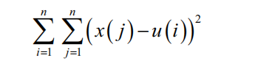
Types of clustering models
K-means clustering- attempts to partition a set of data points into K distinct clusters (where K is an input parameter for the model).
More formally, K-means tries to find clusters so as to minimize the sum of squared errors (or distances) within each cluster. This objective function is known as the within cluster sum of squared errors (WCSS).

Slide 47
K-means iterates between two steps:
1. Assign each data point to the cluster that minimizes the WCSS. The sum
of squares is equivalent to the squared Euclidean distance; therefore, this
equates to assigning each point to the closest cluster center as measured by
the Euclidean distance metric.
2. Compute the new cluster centers based on the cluster assignments from the
first step
1. https://medium.com/@rohanjoseph_91119/learn-with-an-example-hierarchical-clustering-873b5b50890c

Slide 48
Variants
There are many other variants of K-means; they focus on initialization methods or the core model. One of the more common variants is fuzzy K-means. This model does not assign each point to one cluster as K-means does.
Mixture models
A mixture model is essentially an extension of the idea behind fuzzy K-means; however, it makes an assumption that there is an underlying probability distribution that generates the data. For example, we might assume that the data points are drawn from a set of K-independent Gaussian (normal) probability distributions.
The cluster assignments are also soft, so each point is represented by K membership weights in each of the K underlying probability distributions.

Slide 49
Hierarchical clustering
Hierarchical clustering is a structured clustering approach that results in a multilevel hierarchy of clusters, where each cluster might contain many subclusters (or child clusters). Each child cluster is, thus, linked to the parent cluster. This form of clustering is often also called tree clustering.
Agglomerative clustering is a bottom-up approach where:
• Each data point begins in its own cluster
• The similarity (or distance) between each pair of clusters is evaluated
• The pair of clusters that are most similar are found; this pair is then merged to form a new cluster
• The process is repeated until only one top-level cluster remains

Slide 50
Divisive clustering is a top-down approach that works in reverse, starting with one cluster and at each stage, splitting a cluster into two, until all data points are allocated to their own bottom-level cluster.
Evaluating the performance of clustering models
Internal evaluation metrics
Common internal evaluation metrics include the WCSS, the Davies-Bouldin index, the Dunn Index, and the silhouette coefficient.
External evaluation metrics
These include the Rand measure, F-measure, Jaccard index, and others.

Slide 51
SPARK GRPHX
GraphX is Apache Spark's API for graphs and graph-parallel computation.GraphX is the newest component in Spark. It’s a directed multigraph, which means it contains both edges and vertices and can be used to represent a wide range of data structures. It also has associated properties attached to each vertex and edge.
GraphX supports several fundamental operators and an optimized variant of the Pregel API. In addition to these tools, it includes a growing collection of algorithms that help you analyze your data.

Slide 52
GraphX Operators
GraphX, a graph processing platform built on Apache Spark, has a variety of operators for graph processing:
Property operators: Use user-defined functions to change the properties of vertices and edges
Structural operators: Work on the structure of a graph to create a new graph
Join operators: Connect the properties of vertices with external data sources
Aggregate messages: Apply a user-defined function to each edge triplet in the graph
Here are some examples of GraphX operators:
Reverse operator: Creates a new graph by reversing all the edges in the graph. This can be useful for computing the inverse PageRank.
Subgraph operator: Selects vertices and edges of interest.
Mask operator: Creates a subgraph by returning a graph that contains the vertices and edges found in the input graph.
GroupEdges operator: Merges parallel edges in a multigraph.
Union, intersection, and difference operators: Combine two or more graphs into a single graph.

Slide 53
The property graph is a directed multigraph with user defined objects attached to each vertex and edge. A directed multigraph is a directed graph with potentially multiple parallel edges sharing the same source and destination vertex. The ability to support parallel edges simplifies modeling scenarios where there can be multiple relationships.
The core operators that have optimized implementations are defined in Graph and convenient operators that are expressed as a compositions of the core operators are defined in GraphOps
Ref:
https://spark.apache.org/docs/latest/graphx-programming-guide.html
https://spark.apache.org/docs/latest/graphx-programming-guide.html

Slide 54
GraphX Overview
GraphX is a component of Apache Spark for processing and analyzing large-scale graphs. It integrates graph-parallel computation with Spark’s resilient distributed datasets (RDDs), allowing developers to embed graph computation within Spark applications.
Key Features:
Flexible: Combines graph processing with data-parallel pipelines.
Unified API: Same API for graph and data analytics (unified with DataFrames and RDDs).
Scalable: Designed for large-scale graph processing in distributed environments.

Slide 55
Why Graphs Matter in Machine Learning
Relational Data: Many machine learning problems (e.g., social networks, recommender systems, transportation networks) are inherently graph-structured.
Graph Embeddings: Machine learning uses graph embeddings to represent graph nodes in a continuous vector space for tasks like node classification, link prediction, etc.
Applications:
Fraud detection
Social network analysis
Recommender systems (collaborative filtering)

Slide 56
What is Graph-Structured Data?
Data that can be represented as a set of entities (nodes/vertices) and relationships (edges) between them. Common in domains like:
Social Networks
Transportation Networks
Knowledge Graphs (e.g., Wikipedia)
Key Components:
Vertices: Entities (e.g., users, locations)
Edges: Relationships or interactions (e.g., friend connection, flight route)

Slide 57
Graph Analytics
Property Graphs
A property graph is a graph where both vertices and edges have associated properties (key-value pairs).
Components:
Vertices: Represent entities with attributes (e.g., person with name and age).
Edges: Represent relationships with properties (e.g., 'friend', 'colleague').

Slide 58
Common Graph Operators
Subgraph: Extracts a subgraph based on vertex/edge properties.
Join: Combines vertex/edge attributes from external datasets.
Aggregate Messages: Propagates and aggregates information over edges.

Slide 59
Distributed Graphs
Distributed Graph Processing: GraphX divides graphs into partitions that are processed in parallel across Spark clusters.
Allows processing of massive graphs that do not fit into a single machine's memory.
GraphX Unified Analytics Unified API for Graph and Data
GraphX integrates tightly with Spark, allowing users to perform both graph and relational data analysis using a consistent API.
GraphX vs. GraphFrames:
GraphX: Optimized for RDD-based operations.
GraphFrames: Built on top of Spark DataFrames, providing easier-to-use graph operations.

